Slide 1
INFO 371: Data Mining Applications
College of Computing and Informatics
Drexel University
Performance Evaluation and Decision Tree
Yuan An, PhD
Associate Professor

Slide 2
Agenda
Performance evaluation
Accuracy
Precision
Recall
F1-Measure
Data Scaling
Decision Trees

Slide 3
Performance Evaluation

Slide 4
How good is your classification?
Define evaluation metrics
Evaluate the performance based on a set of test data
Accuracy
Precision
Recall
F1-score: combination of precision and recall

Slide 5
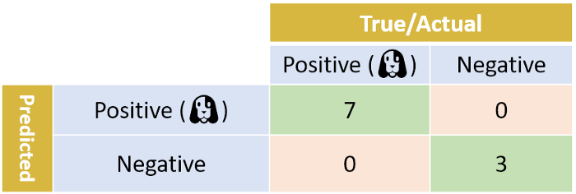
Perfect Binary Classifier
Let’s assume we have 10 photos, and exactly 7 of them have dogs. If our classifier was perfect, the confusion matrix would look like this:
Boaz Shmueli. Multi-Class Metrics Made Simple, Part I: Precision and Recall. https://towardsdatascience.com/multi-class-metrics-made-simple-part-i-precision-and-recall-9250280bddc2

Slide 6

Realistic Binary Classifier
A binary classifier makes two kind of errors: some Positive samples are classified as Negative; and some Negative samples are classified as Positive. Let’s look at a confusion matrix from a more realistic classifier:

Slide 7
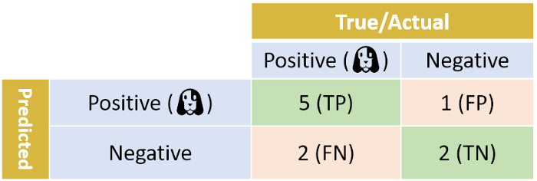
TP, FP, TN, FN
TP, TN: samples correctly classified.
Positive sample is falsely classified as Negative - False Negative (FN)
Negative sample is falsely classified as a Positive - False Positive (FP).

Slide 8
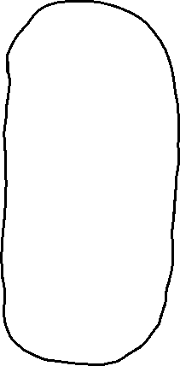








Precision, Recall, Accuracy

Slide 9
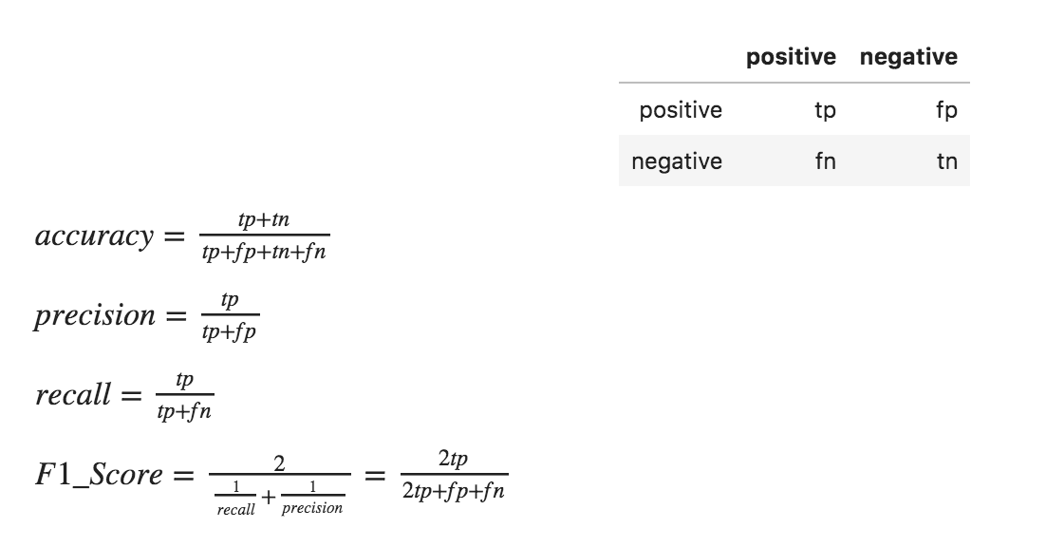
Confusion Matrix and Evaluation Metrics Summary
Harmonic mean

Slide 10
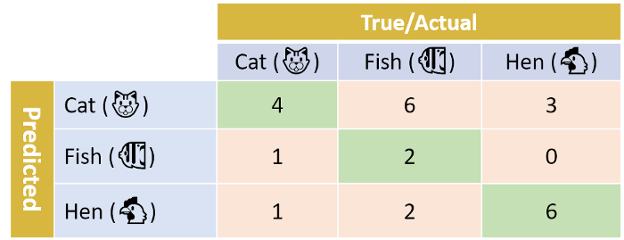
Multiclass Classification
Boaz Shmueli. Multi-Class Metrics Made Simple, Part I: Precision and Recall. https://towardsdatascience.com/multi-class-metrics-made-simple-part-i-precision-and-recall-9250280bddc2

Slide 11
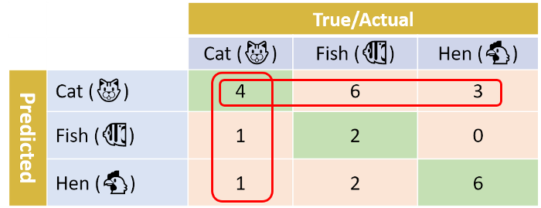
One-vs-Others Evaluation 1

Slide 12
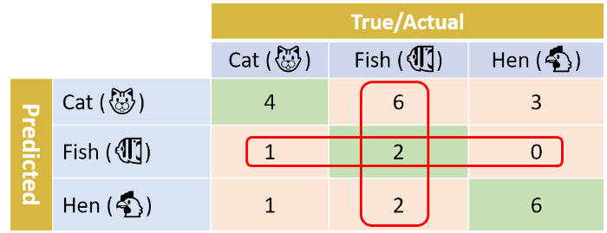
One-vs-Others Evaluation 2

Slide 13
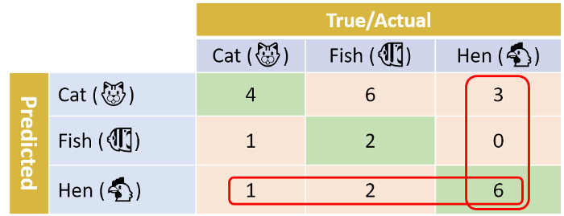
One-vs-Others Evaluation 3

Slide 14
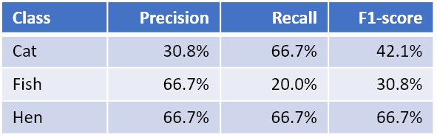
Averages of Metrics
Macro-average:
Macro-precision = (31% + 67% + 67%) / 3 = 54.7%
Macro-recall = (67% + 20% + 67%) / 3 = 51.1%
Macro-F1 = (42.1% + 30.8% + 66.7%) / 3 = 46.5%
Weighted-average:
Weighted-precision=(6 × 30.8% + 10 × 66.7% + 9 × 66.7%)/25 = 58.1%
Weighted-recall = (6 × 66.7% + 10 × 20.0% + 9 × 66.7%) / 25 = 48.0%
Weighted-F1 = (6 × 42.1% + 10 × 30.8% + 9 × 66.7%) / 25 = 46.4%
micro-F1 = micro-precision = micro-recall = accuracy = 48%

Slide 15
Data Scaling

Slide 16
Data Transformation
What attributes to keep/use
Attribute/feature selection and weighting
What type(s) of attributes and conversion
Discretization
Reduction of attributes/dimensions and projections
Reduction of instances and sampling
What about dirty data? Cleansing
Classes? Multiple vs. binary
Converting multiple classes to binary classes

Slide 17
Rescaling
Many techniques are sensitive to the scales of data.
Example, KNN computes different NN when the units of data are different:
A: 63 inches, 160 cm, 150 pounds
B: 67 inches, 170.2 cm, 160 pounds
C: 70 inches, 177.8 cm, 171 pounds
Who is B’s nearest neighbor?
B: using (67, 160) or (170.2, 160)?

Slide 18
Who is B’s Nearest Neibhgor?
B (67 inches, 160 pounds) | A (63 inches, 150 pounds) | Distance = 10.77
B (67 inches, 160 pounds) | C (70 inches, 171 pounds) | Distance = 11.40
B (170.2 cm, 160 pounds) | A (160 cm, 150 pounds) | Distance = 14.28
B (170.2 cm, 160 pounds) | C (177.8 cm, 171 pounds) | Distance = 13.37
After Scaling (x-mean)/std
B (0.095, -0.032) | A (-1.044, -0.983) | Distance = 1.48
B (0.095, -0.032) | C (0.949, 1.015) | Distance = 1.35
B (0.097, -0.032) | A (-1.044, -0.983) | Distance = 1.48
B (0.097, -0.032) | C (0.948, 1.015) | Distance = 1.35

Slide 19
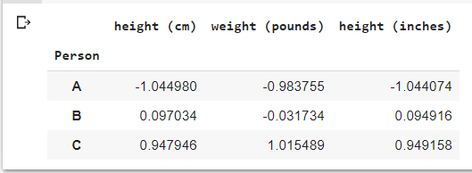
Rescaling: Standardization
Rescale data to mean 0 with standard deviation 1:
x = (x – mean) / sd
Example, standardize the previous example with three people A, B, C:

Slide 20
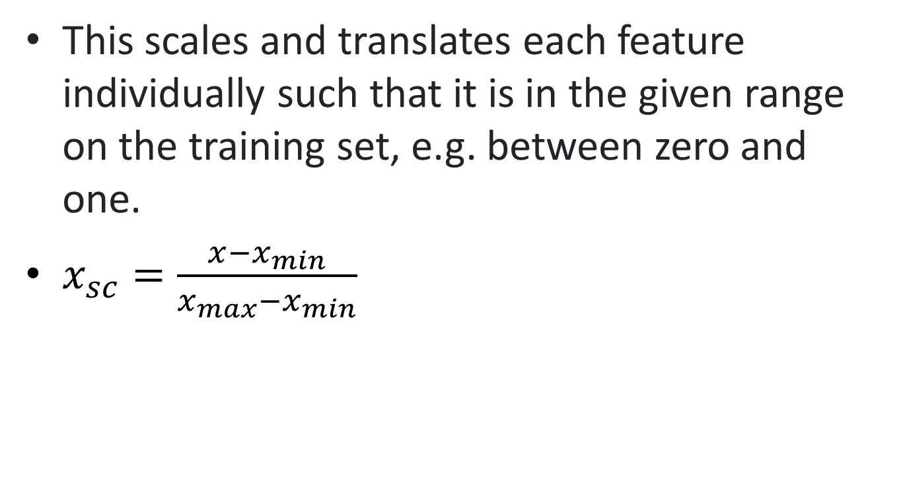
Min-Max Scaling
This scales and translates each feature individually such that it is in the given range on the training set, e.g. between zero and one.
$x_{sc}=\frac{x−x_{min}}{x_{max}−x_{min}}$

Slide 21
Decision Tree Overview

Slide 22
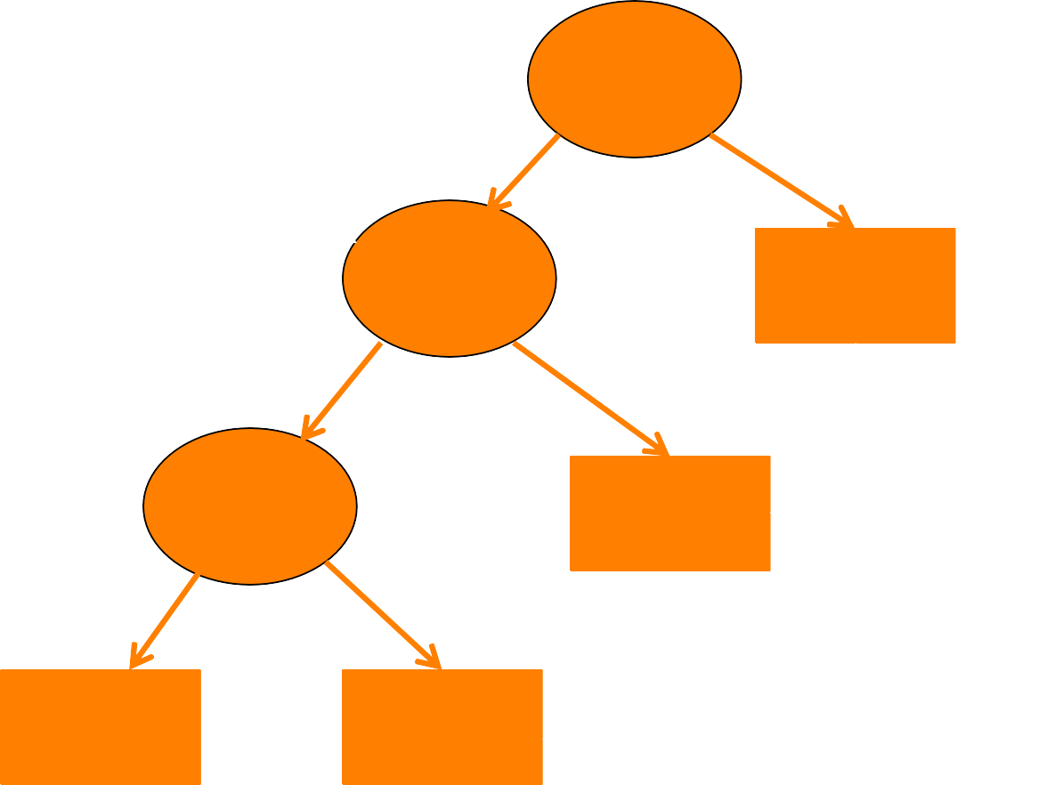
Classification Using Decision Tree
Root Node
Internal Nodes
Leaf Nodes

Slide 23
Classification Using Decision Tree
Root Node
Internal Nodes
Tree Depth = 3 Tree Size = 6
Leaf Nodes

Slide 24
Decision Tree Overview
Idea: Split data into “pure”
Decision Boundaries
regions

Slide 25
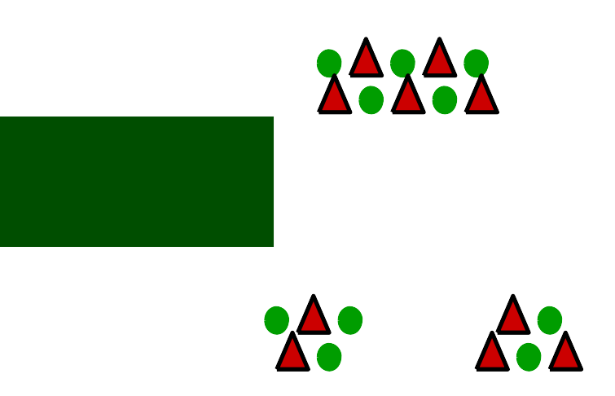
Constructing Decision Tree
Start with all samples at a node.
Partition samples based on input to create purest subsets.
Repeat to partition data into successively purer subsets.
Tree
Induction

Slide 26
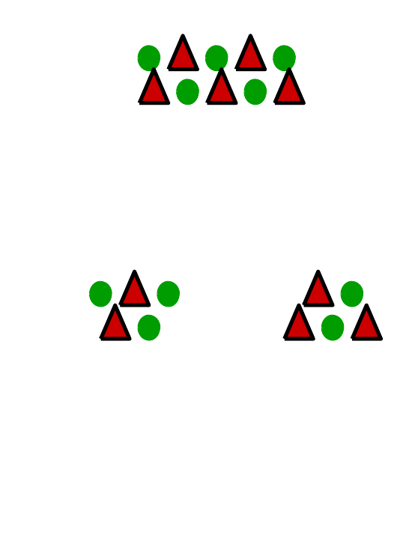
Greedy Approach
What’s the best way to split the current node?

Slide 27
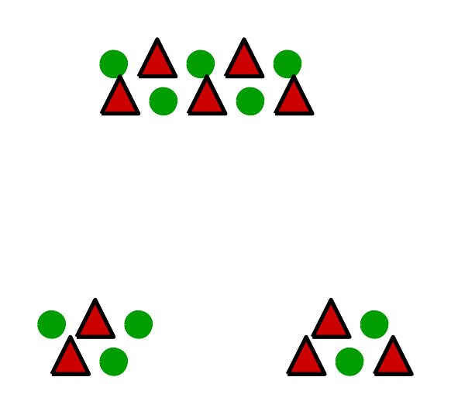
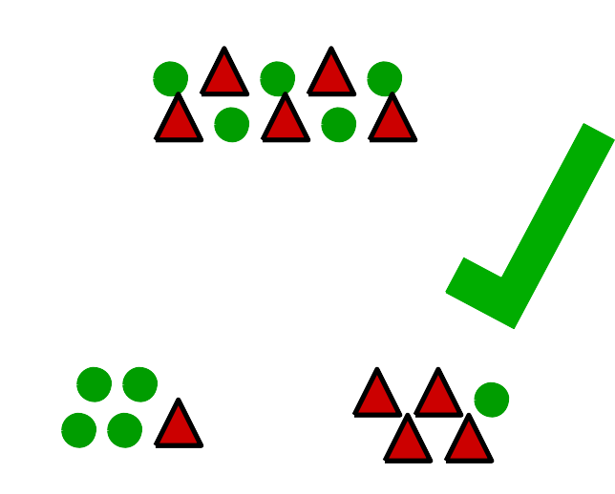
How to Determine Best Split?
Want subsets to be as homogeneous as possible
Less homogeneous = less pure
More homogeneous =
More pure

Slide 28
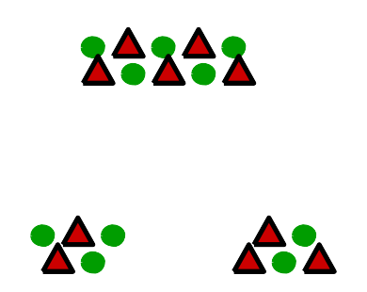
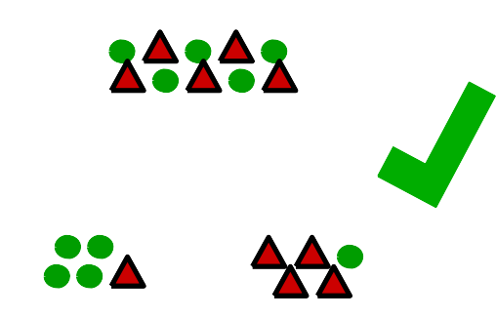
Impurity Measure
To compare different ways to split data in
a node
Higher =
Less pure
Gini
Index
Lower =
More pure

Slide 29
What Variable to Split On?
Splits on all variables. Each variable is tested
Split on var1, var2, … varN

Slide 30

When to Stop Splitting a Node?
All (or X% of) samples have same class label
Number of samples in node reaches minimum
Change in impurity measure is smaller than threshold
Max tree depth is reached
Others…

Slide 31
Decision Tree

Slide 32
Data for Decision Tree Example
Outlook
Temp
Humidity
Windy
Play
Sunny
Hot
High
False
No
Sunny
Hot
High
True
No
Overcast
Hot
High
False
Yes
Rainy
Mild
High
False
Yes
Rainy
Cool
Normal
False
Yes
Rainy
Cool
Normal
True
No
Overcast
Cool
Normal
True
Yes
Sunny
Mild
High
False
No
Sunny
Cool
Normal
False
Yes
Rainy
Mild
Normal
False
Yes
Sunny
Mild
Normal
True
Yes
Overcast
Mild
High
True
Yes
Overcast
Hot
Normal
False
Yes
Rainy
Mild
High
True
No

Slide 33
Constructing decision trees
Strategy: top down learning using recursive divide-and-conquer process
First: select attribute for root node Create branch for each possible attribute value
Then: split instances into subsets One for each branch extending from the node
Finally: repeat recursively for each branch, using only instances that reach the branch
Stop if all instances have the same class

Slide 34
Criterion for attribute selection
Which is the best attribute?
Want to get the smallest tree
Heuristic: choose the attribute that produces the “purest” nodes
Popular selection criterion: information gain
Information gain increases with the average purity of the subsets

Slide 35
Criterion for attribute selection
Strategy: amongst attributes available for splitting, choose attribute that gives greatest information gain
Information gain requires measure of impurity
Impurity measure that it uses is the entropy of the class distribution, which is a measure from information theory

Slide 36
Computing information
We have a probability distribution: the class distribution in a subset of instances
The expected information required to determine an outcome (i.e., class value), is the distribution’s entropy

Slide 37
Computing information
Formula for computing the entropy:
Using base-2 logarithms, entropy gives the information required in expected bits
Entropy is maximal when all classes are equally likely and minimal when one of the classes has probability 1

Slide 38
Information theory

Slide 39
Logarithm Examples

Slide 40
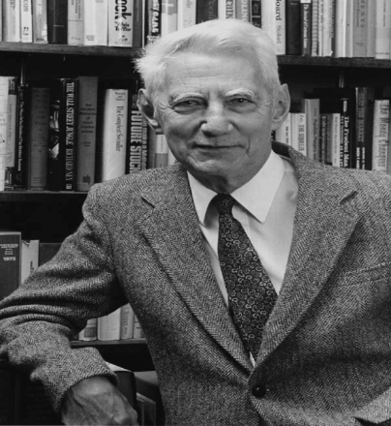
Information Theory
Claude Shannon (1948)
Title: A Mathematical Theory of Communication
Connects information with uncertainty (entropy)
Important assumption (which you may not agree:)
Receiving information (I) reduces uncertainty/entropy (H).
Or, information is the decrease of uncertainty.
Suppose
Your initial uncertainty about something is H₀
Your uncertainty after getting information is H₁
H₁ = 0 if you are certain now (it is known and there is no uncertainty)
Then, the amount of information you’ve received is
I = H₀ – H₁
= H₀ if you are completely certain now (H₁=0)
Claude Shannon

Slide 41
Information Theory – entropy
Now how do we measure uncertainty/entropy
then we’ll be able to measure information
According to Shannon (1948), entropy is:
given M choices (different potential outcomes)
P_{i} is the probability of the i^{th} choice (the likelihood that the i^{th} will come true)

Slide 42
Entropy of Flipping a Coin

Slide 43
Information Theory – Example
An example about election:
Three candidates 1, 2, and 3 running for office
The probability of each candidate being elected is:
P1 = 0.1, P2 = 0.5, P3 = 0.4. Apparently, they should add up to 1.0.
Before the result is out, the uncertainty about the election is:
After election, result/information is known:
No matter which candidate wins, there is no uncertainty
The amount of information about election is:
I = H₀ – H₁ = H₀ = 0.41

Slide 44
Information Theory – Example
Election example continued
Case 1: suppose it is a tight election, three candidates have the equal chances to win: P1 = P2 = P3 = 1/3
Intuitively, election result is harder to predict
Uncertainty should be larger
Yes, the entropy formula tells the same story:
Case 2: suppose it is an easy election for candidate 2, who has 90% likelihood to win
Say P1=0.01, P2=0.9, P3=0.09
Uncertainty should be smaller
Yes, the number is consistent:
Notes:
Which one is more certain / uncertain? Intuition?
General conclusion: equal choices → more uncertainty

Slide 45
Information Theory - importance
Shannon’s equation was a very important discovery:
In a sense, its significance to communication/computing/information sciences can be likened to that of Einstein’s E=MC² to physics.
It enables us to measure the amount of information and estimate capacities needed to communicate and/or store that amount of information.
It provides guidance on information compression.
It lays foundations for digital information technologies (dealing with bits)
…

Slide 46
Information Theory - characteristics
Why is this THE formula?
What makes it meaningful?
Three important characteristics, among others:
H is continuous in the p_{i}. That is, smooth changes in probability values cause smooth (not sudden/dramatic) changes of H.
H is larger given a larger M – that is, in general, there is more uncertainty given more choices (some qualifications).
If a choice is broken down into two successive choices, the original H is the weighted sum of the individual values of H.

Slide 47
Decision Tree (Con’t)

Slide 48
Information Theory – entropy
Now how do we measure uncertainty/entropy
then we’ll be able to measure information
According to Shannon (1948), entropy is:
given M choices (different potential outcomes)
P_{i} is the probability of the i^{th} choice (the likelihood that the i^{th} will come true)

Slide 49
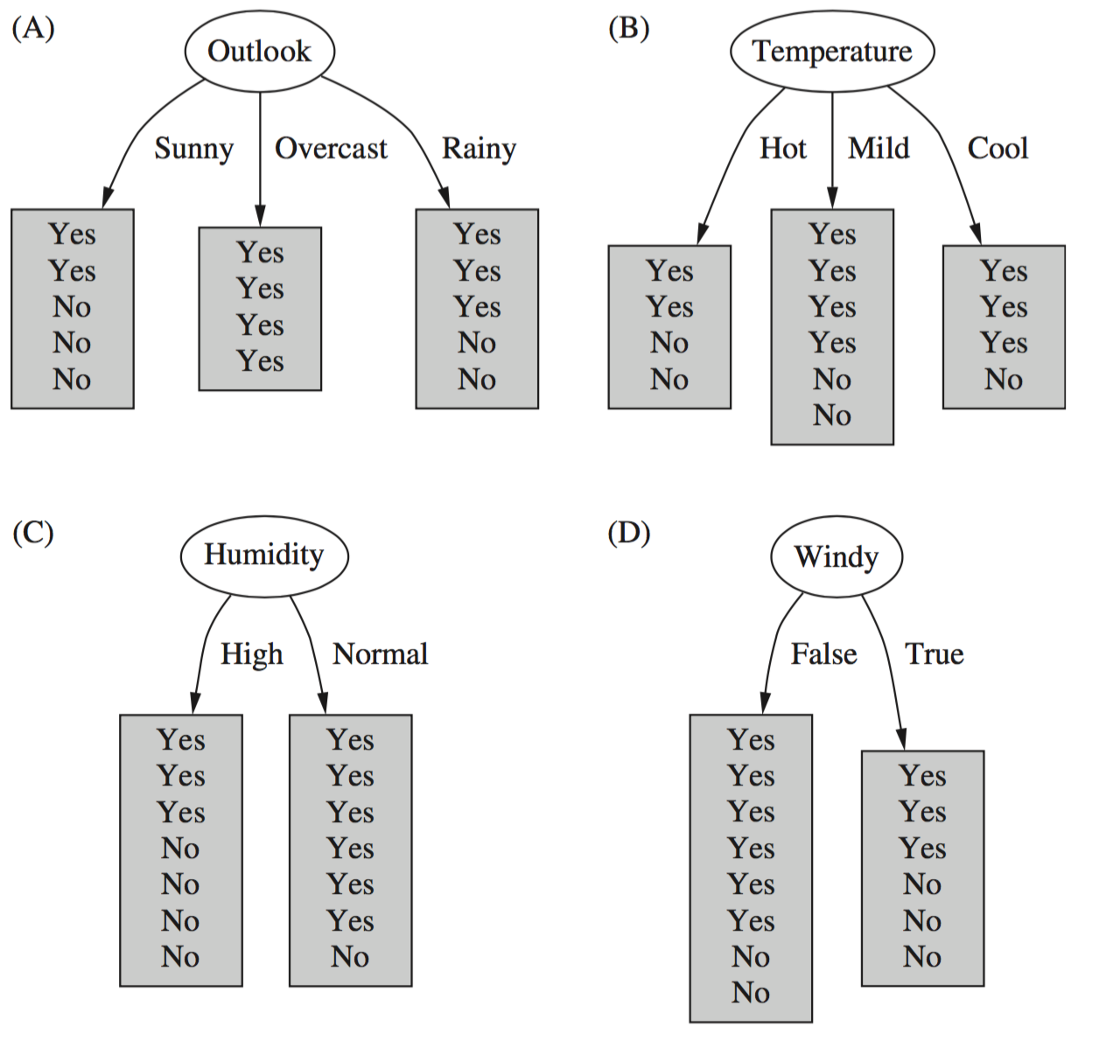
Which attribute to select?

Slide 50
Computing information gain
Information gain: information before splitting
Info(Play )= Info([9,5])
= - (9/14) x log (9/14) – (5/14) x log (5/14)
= 0.94
Outlook
Temp
Humidity
Windy
Play
Sunny
Hot
High
False
No
Sunny
Hot
High
True
No
Overcast
Hot
High
False
Yes
Rainy
Mild
High
False
Yes
Rainy
Cool
Normal
False
Yes
Rainy
Cool
Normal
True
No
Overcast
Cool
Normal
True
Yes
Sunny
Mild
High
False
No
Sunny
Cool
Normal
False
Yes
Rainy
Mild
Normal
False
Yes
Sunny
Mild
Normal
True
Yes
Overcast
Mild
High
True
Yes
Overcast
Hot
Normal
False
Yes
Rainy
Mild
High
True
No

Slide 51




Computing information gain
Information gain: information after splitting on Outlook:
Outlook = Sunny :
Outlook = Overcast :
Outlook = Rainy :
Expected information for attribute:

Slide 52
Computing information gain
Information gain: information before splitting – information after splitting
Information gain for attributes from weather data:
Gain(Outlook ) = Info([9,5]) – info([2,3],[4,0],[3,2])
= 0.940 – 0.693 = 0.247 bits
Gain(Outlook ) = 0.247 bits
Gain(Temperature ) = 0.029 bits
Gain(Humidity ) = 0.152 bits
Gain(Windy ) = 0.048 bits

Slide 53
Which attribute to select?

Slide 54
Which attribute to select?

Slide 55
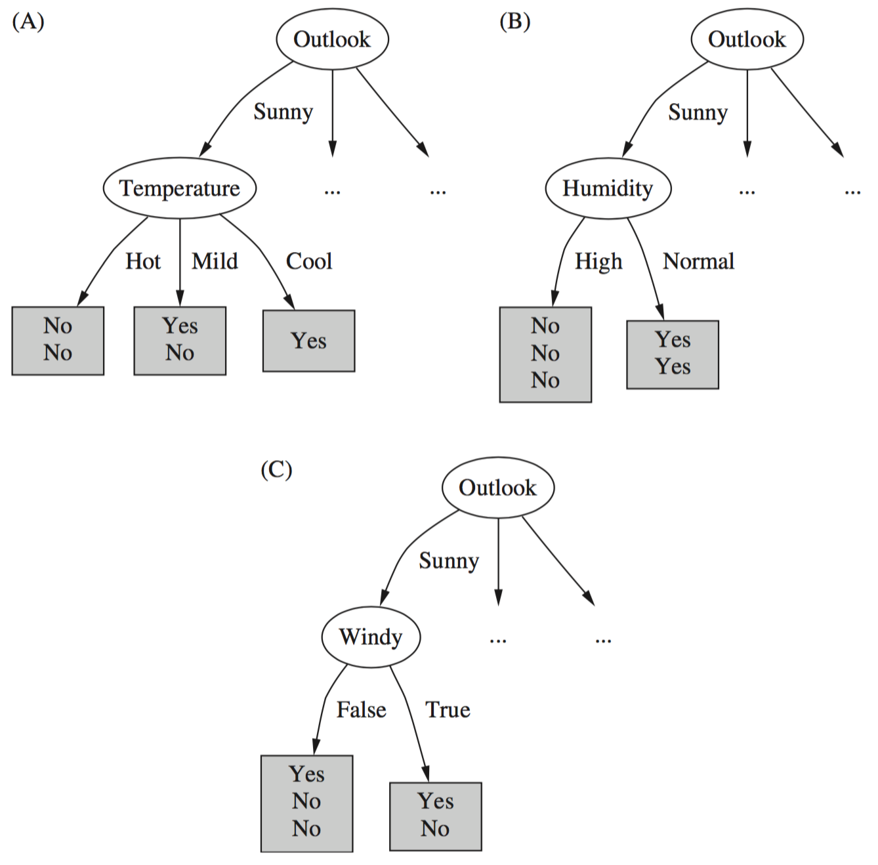
Continuing to split
Gain(Temperature ) = 0.571 bits
Gain(Humidity ) = 0.971 bits
Gain(Windy ) = 0.020 bits

Slide 56
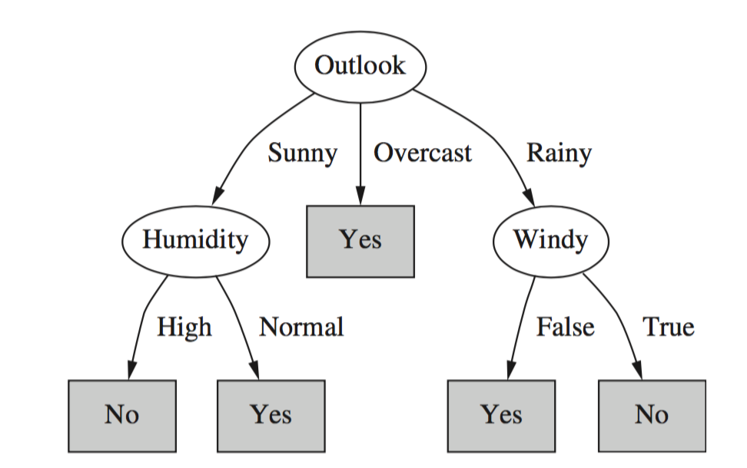
Final decision tree
Note: not all leaves need to be pure; sometimes identical instances have different classes
Splitting stops when data cannot be split any further

Slide 57
Discussion
Top-down induction of decision trees: ID3, algorithm developed by Ross Quinlan
Gain ratio just one modification of this basic algorithm
C4.5 tree learner deals with numeric attributes, missing values, noisy data
Similar approach: CART tree learner
Uses Gini index rather than entropy to measure impurity
There are many other attribute selection criteria! (But little difference in accuracy of result)

